Slide 1
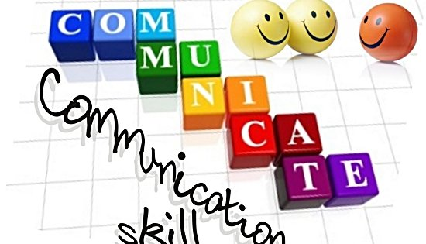
Lets’ Communicate- To Succeed
Notes:
1

Slide 2
Objectives
Define and understand communication and the communication process
List and overcome the filters/barriers in a communication process
Practice active listening
Tips to improve verbal and non verbal communication

Slide 3
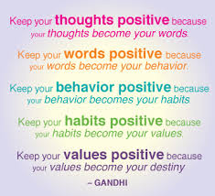
Time To Think:

Slide 4
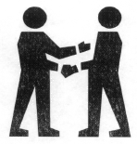
What is Communication?
COMMUNICATION IS THE ART OF TRANSMITTING INFORMATION, IDEAS AND ATTITUDES FROM ONE PERSON TO ANOTHER.COMMUNICATION IS THE PROCESS OF MEANINGFUL INTERACTION AMONG HUMAN BEINGS.
ITS ESSENCES :
PERSONAL PROCESS
OCCURS BETWEEN PEOPLE
INVOLVES CHANGE IN BEHAVIOUR
MEANS TO INFLUENCE OTHERS
EXPRESSION OF THOUGHTS AND
EMOTIONS THROUGH WORDS & ACTIONS.
TOOLS FOR CONTROLLING AND MOTIVATING PEOPLE.
IT IS A SOCIAL AND EMOTIONAL PROCESS.

Slide 5
What are the most common ways we communicate?
Visual Images
Spoken Word
Written Word
Body Language

Slide 6
ESTABLISHING RAPPORT
Field of Consciousness

Slide 7
How do you go about Establishing Rapport?
You need Self-Confidence
You must Understand People
You must be Enthusiastic
You must make Eye Contact
You must be Interested in them

Slide 8
Communication is a Series of Experiences of
Smell
Hearing
Seeing
Taste

Slide 9
TOTAL COMMUNICATION PROCESS

Slide 10
Types of Communication
Downwards Communication : Highly Directive, from Senior to subordinates, to assign duties, give instructions, to inform to offer feed back, approval to highlight problems etc.
Upwards Communications : It is non directive in nature from down below, to give feedback, to inform about progress/problems, seeking approvals.
Lateral or Horizontal
Communication : Among colleagues, peers at same level for information
level for information sharing for coordination, to save time.
In modern business environment communication extends beyond written or spoken
words to listened word.
Visual dimension added by T.V., computers has given to new meaning to
communication.
COMMUNICATION NETWORKS
Formal Network : Virtually vertical as per chain go command within the
hierarchy.
Informal Network : Free to move in any direction may skip formal chain of
command. Likely to satisfy social and emotional needs
and also can facilitate task accomplishment.

Slide 11
HIERARCHY LEVEL
Downward Comm.
Upward Comm.
Horizontal Comm.

Slide 12
LEVELS OF COMMUNICATION
VERBAL
Intra verbal: intonation of word and sound
Extra verbal : implication of words and phrases, semantics
NON-VERBAL
Gestures
Postures
Movements
SYMBOLIC

Slide 13



Barriers to communication
Noise
Inappropriate medium
Assumptions/Misconceptions
Emotions
Language differences
Poor listening skills
Distractions

Slide 14
Hearing Vs Listening
Hearing – Physical process, natural, passive
Listening – Physical as well
as mental process, active,
learned process, a skill
Listening is hard.
You must choose to participate in the process of listening.

Slide 15
VALUE OF LISTENING
Listening to others is an elegant art.
Good listening reflects courtesy and good manners.
Listening carefully to the instructions of superiors improve competence and performance.
The result of poor listening skill could be disastrous in business, employment and social relations.
Good listening can eliminate a number of imaginary grievances of employees.
Good listening skill can improve social relations and conversation.
Listening is a positive activity rather than a passive or negative activity.

Slide 16
ESSENTIALS OF COMMUNICATION DON’Ts
Do not instantly react and mutter something in anger.
Do not use technical terms & terminologies not understood by majority of people.
Do not speak too fast or too slow.
Do not speak in inaudible surroundings, as you won’t be heard.
Do not assume that every body understands you.
While listening do not glance here and there as it might distract the speaker.
Do not interrupt the speaker.
Do not jump to the conclusion that you have understood every thing.

Slide 17
Barriers in Communication (that have to do with the COMMUNICATOR
Unwillingness to say things differently
Unwillingness to relate to others differently
Unwillingness to learn new approaches
Lack of Self-Confidence
Lack of Enthusiasm
Voice quality
Prejudice

Slide 18
Barriers in Communication (that have to do with the RECEIVER
Selective Perception
Unwillingness to Change
Lack of Interest in the Topic/Subject
Prejudice & Belief System
Rebuttal Instincts
Personal Value System
Here-and-Now internal & external factors

Slide 19
External Barriers in Communication
Environment
The venue
The effect of noise
Temperature in the room
Other People – Status, Education
Time

Slide 20
5 Basic reasons we Do Not Listen
Listening is Hard Work
Competition
The Rush for Action
Speed differences (120 wpm v/s 360 wpm)
Lack of Training

Slide 21
Telephonic Conversation Telephone Etiquette :
A warm, helpful, professional and friendly voice on the phone can build customer loyalty.
GREET
LISTEN
EMPATHIZE
PROBE
COMMON COURTESIES
. AVOID COMPANY JARGON & RULES
OFFER SOLUTIONS/ALTERNATIVES
TONE
GO TO THE EXTRA MILE
APPRECIATE

Slide 22
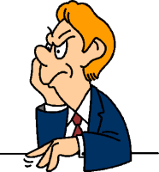
Improving Body Language - Tips
Keep appropriate distance
Touch only when appropriate
Take care of your appearance
Be aware - people may give false cues
Maintain eye contact
Smile genuinely

Slide 23
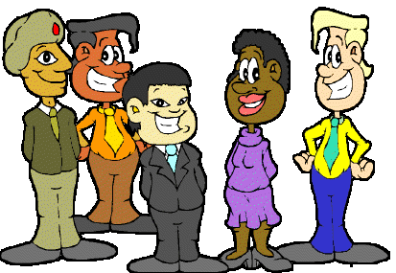
Success for YOU…
…in the new global and diverse workplace requires excellent communication skills!

Slide 24
Questions

